Slide 1
Data Analytics in Student Success
DAI Final Capstone
Evelyn Davis
Notes:
Good afternoon everyone, my name is Evelyn Davis, My topic is data analytics in student success.

Slide 2
ABOUT ME
Name
Evelyn Davis
Background
Job
Curriculum Developer
Sergeant in the United States Space Force
Trained computer system programmer
Degrees in computer science and math
Develop curriculum for cyber career field
Interests
Travel
Sport
Health
Music
Art
Tech
Notes:
Little bit about me…
As a curriculum developers, It's important to know and understand how to best train our airman. Those factors for student success

Slide 3
MOTIVATION
Purpose
AETC mission:
Recruit, train, and educate exceptional Airmen.
Train and Educate in the Air Force:
Student academic performance factors
Behavioral analysis
Improve training and education
Notes:
My mission is to support the Air Force Education and Training Command. We are focusing on recruiting, train, and educating exceptional Airmen. What are the factors of the student's academic performance? Is there a relationship between students’ behavioral features? How can we improve our training and education in the department of the Air Force? In this capstone, I will use data virtualization and statistical tools to review some of the key factors affecting students’ success and how to improve our students’ performance in training.

Slide 4
DATA
SOURCE
STRUCTURE
CATEGORIE
FOCUS
Learner activity tracker XAPI
480 records
16 features
Demographic
Academic
Behavioural
Raised hand
Visited resources
Viewed announcement
Participated discussion
Notes:
The data is collected using a learner activity tracker tool, which called experience API (xAPI). The xAPI is a component of the training and learning architecture (TLA) that enables to monitor learning progress and learner’s actions like reading an article or watching a training video.
The dataset consists of 480 student records and 16 features. The features are classified into three major categories: Demographic features, Academic background features, and Behavioral features such as raised hand on class, visiting resources, checking announcement view, and participating the discussion groups.
My project focused on the behavioral features since students can improve on those features.

Slide 5
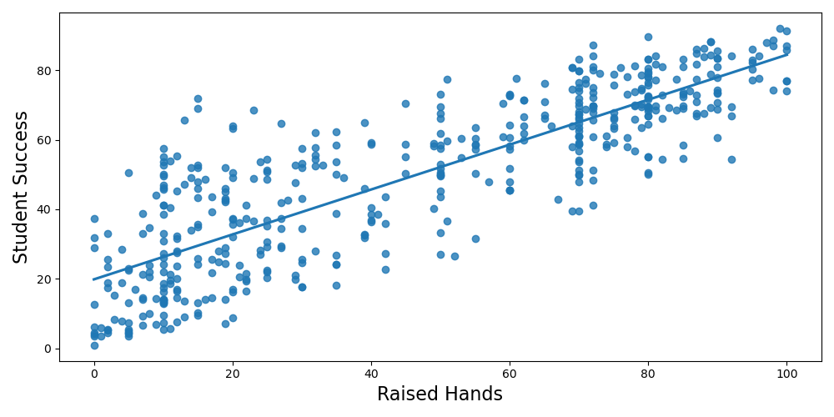
RAISED HANDS
Notes:
First one is raised hands… This column collected how many times the student raised his/her hand during class.
The relationship between the student success and raised hands is linear and positive.

Slide 6
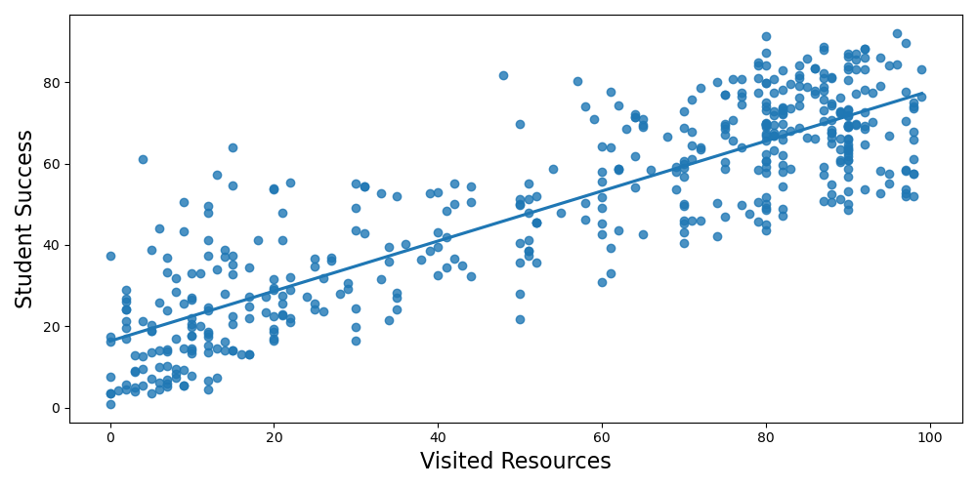
VISITED RESOURCES
Notes:
The second behavior feature is visited resources, this column collected how many times the student visits a course content.
The relationship between the student success and visited resources is linear and positive.

Slide 7
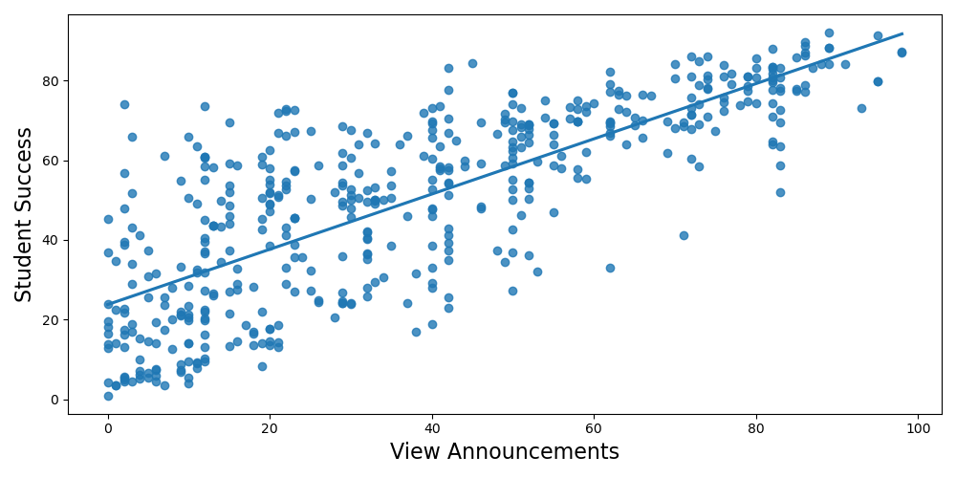
VIEW ANNOUNCEMENTS
Notes:
The third behavior feature is announcement's view, this column collected how many times the student checks the new announcements.
The relationship between the student success and announcement's view is linear and positive.

Slide 8
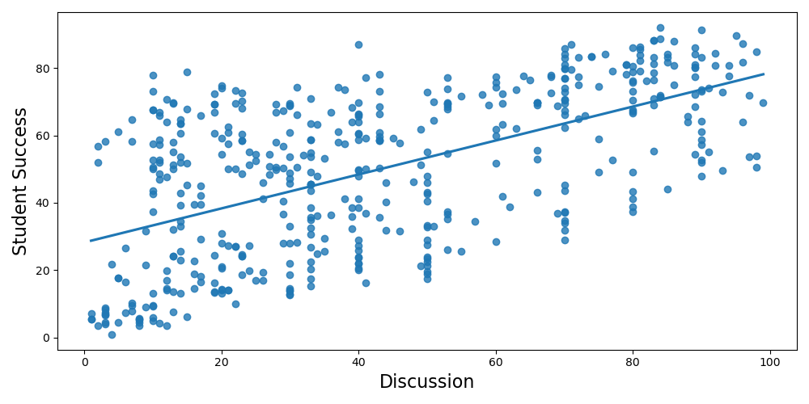
DISCUSSION
Notes:
Finally, the last behavior feature is discussion, this column collected how many times the student participate on discussion groups.
The relationship between the student success and participated discussion is linear and positive.

Slide 9
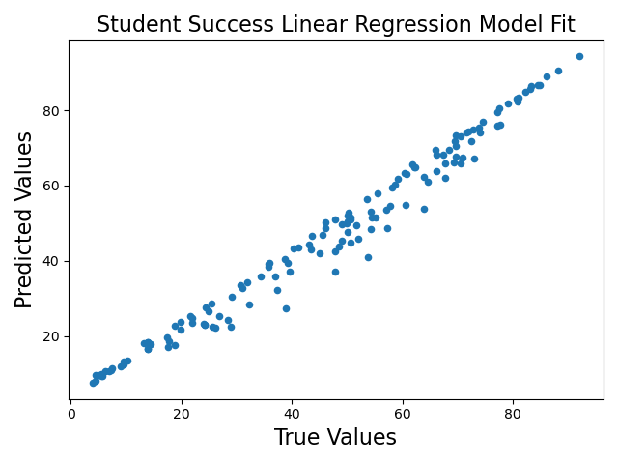
LINEAR REGRESSION
Coef
P-value
Raised Hand
6.638
0.122
Visited Resources
11.212
0.006
Viewed Announcements
4.710
0.233
Raised Hand
Viewed Announcements
Increased 6.638 points
Increased 4.710 points
Visited Resources
Participated Discussion
Participated Discussion
6.683
0.034
Increased 11.212 points
Increased 6.683 points
Notes:
Now we know the relationship between our behavior features and student success variables are linear.
After plotting the heatmap to check the correlation between my variables, there is little or no multicollinearity in the data, also there is no autocorrelation between by data.
Then I plotted the histogram and scatter plot, all the variables are multivariate normal, and the residuals are mostly equal across the line of regression.
Now we can make a linear regression for my data…
According to the p-value, we see stronger relationship between visited resources and participated discussion with students' success than raised hand and viewed announcements.
We are more confident that visited resources and participated discussion have positive relationship with students’ success.
Therefore, I come to the following summary suggestion…

Slide 10
SUMMARY SUGGESTION
Activities
Evaluation
Feedback
Create more group activities
Encourage students to visit more course content
Students
Give valuable feedback to students in class
Monitor students’ behaviors progress
Encourage students engagement in class
Encourage students to participate in the group discussion
Observations
Grades

Slide 11
FUTURE WORK
More data: The original data only has 480 instance and 16 attributes, collecting more data could improve accuracy.
Hypothesis testing: Welch two sample T-test, and Chi-squared test to see if student behaviour differ by demographic features.

Slide 12

CREDITS: This presentation used graphic designs provided by Slidesgo, including icons by Flaticon, and infographics & images by freepik
THANKS
evelyn.davis.1@spaceforce.mil
+1 228-377-0651
/dyan27/dai-capstone

